Slide 1

C++ Basic Elements

Slide 2
A C++ Program
#include <iostream>
using namespace std;
int main()
{
int num;
num = 6;
cout << "My first C++ program." << endl;
cout << "The sum of 2 and 3 = " << 5 << endl;
cout << "7 + 8 = " << 7 + 8 << endl;
cout << "Num = " << num << endl;
return 0;
}

Slide 3
The Basics of a C++ Program
Function: collection of statements; when executed, accomplishes something
May be predefined or standard
Syntax: rules that specify which statements (instructions) are legal
Programming language: a set of rules, symbols, and special words
Semantic rule: meaning of the instruction

Slide 4
Comments
Comments are for the reader, not the compiler
Two types:
Single line
// This is a C++ program. It prints the sentence:
// Welcome to C++ Programming.
Multiple line
/*
You can include comments that can
occupy several lines.
*/

Slide 5
Special Symbols
Special symbols
+
-
*
/
.
;
?
,
<=
!=
==
>=

Slide 6
Reserved Words (Keywords)
Reserved words, keywords, or word symbols
Include:
int
float
double
char
const
void
return

Slide 7
Identifier
Consist of letters, digits, and the underscore character (_)
Must begin with a letter or underscore
C++ is case sensitive
NUMBER is not the same as number
Two predefined identifiers are cout and cin

Slide 8
Identifiers
Legal identifiers in C++:
first
conversion
payRate

Slide 9
Whitespaces
Every C++ program contains whitespaces
Include blanks, tabs, and newline characters
Used to separate special symbols, reserved words, and identifiers
Proper utilization of whitespaces is important
Can be used to make the program readable

Slide 10
Data Types
Data type: set of values together with a set of operations
C++ data types fall into three categories:

Slide 11
Simple Data Types
Three categories of simple data
Integral: integers (numbers without a decimal)
Floating-point: decimal numbers
Enumeration type: user-defined data type

Slide 12
Simple Data Types
Integral data types are further classified into nine categories:
char, short, int, long, bool
unsigned char, unsigned short, unsigned int, unsigned long

Slide 13
Simple Data Types
Different compilers may allow different ranges of values

Slide 14
int Data Type
Examples:
-1234
0
15
+567
Positive integers do not need a + sign
No commas are used within an integer
Commas are used for separating items in a list

Slide 15
bool Data Type
bool type
Two values: true and false
Manipulate logical (Boolean) expressions
true and false
Logical values
bool, true, and false
Reserved words

Slide 16
char Data Type
The smallest integral data type
Used for characters: letters, digits, and special symbols
Each character is enclosed in single quotes
'A', 'a', '0', '*', '+', '$', '&'
A blank space is a character
Written ' ', with a space left between the single quotes

Slide 17
Floating-Point Data Types
C++ uses scientific notation to represent real numbers (floating-point notation)

Slide 18
Floating-Point Data Types
float: represents any real number
Range: -3.4E+38 to 3.4E+38 (four bytes)
double: represents any real number
Range: -1.7E+308 to 1.7E+308 (eight bytes)

Slide 19
Floating-Point Data Types
Maximum number of significant digits (decimal places) for float values is 6 or 7
Maximum number of significant digits for double is 15
Precision: maximum number of significant digits
Float values are called single precision
Double values are called double precision

Slide 20
Arithmetic Operators and Operator Precedence
C++ arithmetic operators:
+ addition
- subtraction
* multiplication
/ division
% modulus operator
+, -, *, and / can be used with integral and floating-point data types
Operators can be unary or binary

Slide 21
Order of Precedence
All operations inside of () are evaluated first
*, /, and % are at the same level of precedence and are evaluated next
+ and – have the same level of precedence and are evaluated last
When operators are on the same level
Performed from left to right (associativity)
4 * 5 - 3 + 2 * 6 / 3 + 6 means
(((4 * 5) – 3) + ((2 * 6) / 3 )) + 6

Slide 22
Expressions
If all operands are integers
Expression is called an integral expression
Yields an integral result
Example: 2 + 3 * 5
If all operands are floating-point
Expression is called a floating-point expression
Yields a floating-point result
Example: 12.8 * 17.5 - 34.50

Slide 23
Mixed Expressions
Mixed expression:
Has operands of different data types
Contains integers and floating-point
Examples of mixed expressions:
4 + 10.5
7 / 3 + 4.5
5.5 * 3 – 15.7 + 10 / 4

Slide 24
Mixed Expressions
Evaluation rules:
If operator has same types of operands
Evaluated according to the type of the operands
If operator has both types of operands
Integer is changed to floating-point
Operator is evaluated
Result is floating-point
Entire expression is evaluated according to precedence rules

Slide 25
Type Conversion (Casting)
Implicit type coercion: when value of one type is automatically changed to another type
Cast operator: provides explicit type conversion
static_cast<dataTypeName>(expression)

Slide 26
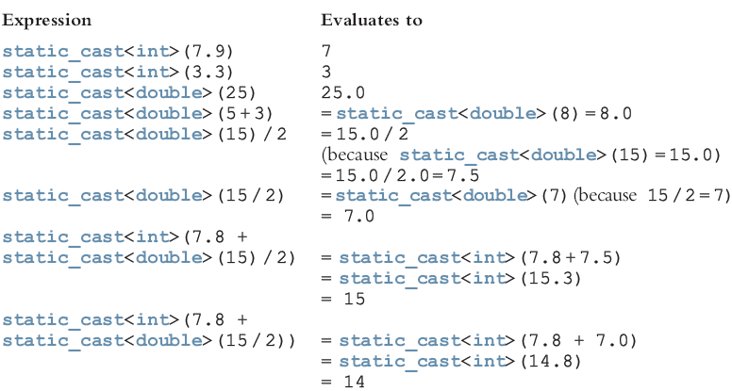
Type Conversion

Slide 27
string Type
Programmer-defined type supplied in ANSI/ISO Standard C++ library
Sequence of zero or more characters
Enclosed in double quotation marks
Null: a string with no characters
Each character has relative position in string
Position of first character is 0
Length of a string is number of characters in it
Example: length of “Jose Antonio" is 12

Slide 28
Input
Data must be loaded into main memory before it can be manipulated
Storing data in memory is a two-step process:
Instruct computer to allocate memory
Include statements to put data into memory

Slide 29

Allocating Memory with Constants and Variables
Named constant: memory location whose content can’t change during execution
The syntax to declare a named constant is:
In C++, const is a reserved word

Slide 30
Allocating Memory with Constants and Variables
Variable: memory location whose content may change during execution
The syntax to declare a named constant is:

Slide 31
Putting Data into Variables
Ways to place data into a variable:
Use C++’s assignment statement
Use input (read) statements

Slide 32
Assignment Statement
The assignment statement takes the form:
Expression is evaluated and its value is assigned to the variable on the left side
In C++, = is called the assignment operator

Slide 33
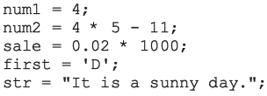
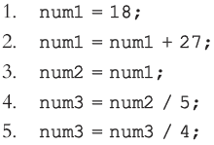
Assignment Statement Example:

Slide 34
Saving and Using the Value of an Expression
To save the value of an expression:
Declare a variable of the appropriate data type
Assign the value of the expression to the variable that was declared
Use the assignment statement
Wherever the value of the expression is needed, use the variable holding the value

Slide 35
Declaring & Initializing Variables
Variables can be initialized when declared:
int num1=13, num2=10;
char ch=' ';
double x=12.6;
All variables must be initialized before they are used
But not necessarily during declaration

Slide 36

Input (Read) Statement
cin is used with >> to gather input
The stream extraction operator is >>
For example, if miles is a double variable
cin >> miles;
Causes computer to get a value of type double
Places it in the variable miles

Slide 37
Input (Read) Statement
Using more than one variable in cin allows more than one value to be read at a time
For example, if feet and inches are variables of type int, a statement such as:
cin >> feet >> inches;
Inputs two integers from the keyboard
Places them in variables feet and inches respectively

Slide 38
Variable Initialization
There are two ways to initialize a variable:
int feet;
By using the assignment statement
feet = 35;
By using a read statement
cin >> feet;

Slide 39
Increment and Decrement Operators
Increment operator: increment variable by 1
Pre-increment: ++variable
Post-increment: variable++
Decrement operator: decrement variable by 1
Pre-decrement: --variable
Post-decrement: variable—
What is the difference between the following?
x = 7;
y = ++x;
x = 7;
y = x++;

Slide 40
Output
The syntax of cout and << is:
Called an output statement
The stream insertion operator is <<
Expression evaluated and its value is printed at the current cursor position on the screen

Slide 41
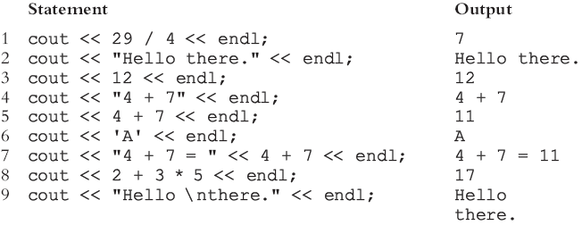
Output
A manipulator is used to format the output
Example: endl causes insertion point to move to beginning of next line

Slide 42
Output:

Slide 43
Preprocessor Directives
C++ has a small number of operations
Many functions and symbols needed to run a C++ program are provided as collection of libraries
Every library has a name and is referred to by a header file
Preprocessor directives are commands supplied to the preprocessor
All preprocessor commands begin with #
No semicolon at the end of these commands

Slide 44
Preprocessor Directives (cont'd.)
Syntax to include a header file:
For example:
#include <iostream>
Causes the preprocessor to include the header file iostream in the program

Slide 45
namespace and Using cin and cout in a Program
cin and cout are declared in the header file iostream, but within std namespace
To use cin and cout in a program, use the following two statements:
#include <iostream>
using namespace std;

Slide 46
Using the string Data Type in a Program
To use the string type, you need to access its definition from the header file string
Include the following preprocessor directive:
#include <string>

Slide 47
Creating a C++ Program
C++ program has two parts:
Preprocessor directives
The program
Preprocessor directives and program statements constitute C++ source code (.cpp)
Compiler generates object code (.obj)
Executable code is produced and saved in a file with the file extension .exe

Slide 48
Creating a C++ Program
A C++ program is a collection of functions, one of which is the function main
The first line of the function main is called the heading of the function:
int main()
The statements enclosed between the curly braces ({ and }) form the body of the function
Contains two types of statements:
Declaration statements
Executable statements

Slide 49
Program Style and Form
Every C++ program has a function main
Programs must also follow syntax rules
Other rules serve the purpose of giving precise meaning to the language

Slide 50
Use of Blanks
In C++, you use one or more blanks to separate numbers when data is input
Used to separate reserved words and identifiers from each other and from other symbols
Must never appear within a reserved word or identifier

Slide 51
Use of Semicolons, Brackets, and Commas
All C++ statements end with a semicolon
Also called a statement terminator
{ and } are not C++ statements
Commas separate items in a list

Slide 52
Semantics
Possible to remove all syntax errors in a program and still not have it run
Even if it runs, it may still not do what you meant it to do
For example,
4 + 5 * 6 and (4 + 5) * 6
are both syntactically correct expressions, but have different meanings

Slide 53
Naming Identifiers
Identifiers can be self-documenting:
CENTIMETERS_PER_INCH
Avoid run-together words :
annualsale
Solution:
Capitalize the beginning of each new word: annualSale
Inserting an underscore just before a new word: annual_sale

Slide 54
Prompt Lines
Prompt lines: executable statements that inform the user what to do
cout << "Please enter a number between 1 and 10 and "
<< "press the return key" << endl;
cin >> num;

Slide 55
Documentation
A well-documented program is easier to understand and modify
You use comments to document programs
Comments should appear in a program to:
Explain the purpose of the program
Identify who wrote it
Explain the purpose of particular statements

Slide 56
Form and Style
Consider two ways of declaring variables:
Method 1
int feet, inch;
double x, y;
Method 2
int feet,inch;double x,y;
Both are correct; however, the second is hard to read

Slide 57
More on Assignment Statements
C++ has special assignment statements called compound assignments
+=, -=, *=, /=, and %=
Example:
x *= y;

Slide 58


